Slide 1
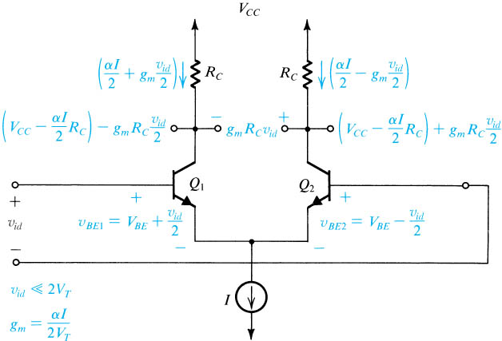

Small-signal operation of the BJT differential amplifier
g_{m} = I_{C}/V_{T}
i_{c} = g_{m}v_{i}
The currents and voltages in the differential amplifier when a small differential input signal v_{id} is applied.

Slide 2
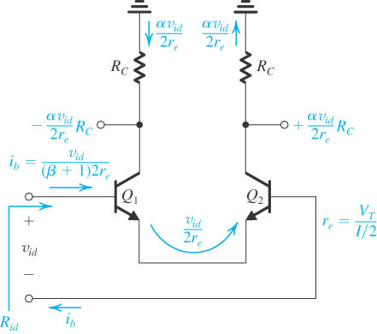
Small-Signal Operation
i_{b} = i_{e}/(β+1)
A simple technique for determining the signal currents in a differential amplifier excited by a differential voltage signal v_{id}; dc quantities are not shown.

Slide 3
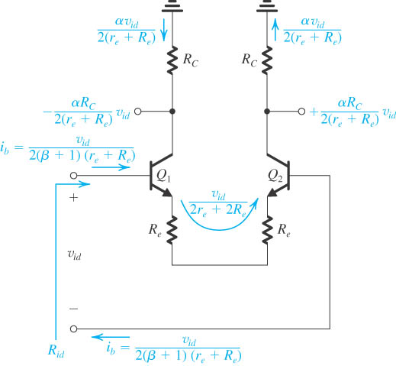
Small-Signal Operation
A differential amplifier with emitter resistances.
Only signal quantities are shown (in color).

Slide 4
Input Differential Resistance
The resistance seen between the two bases is equal to the total resistance in the emitter circuit multiplied by (1+β).
Input differential resistance of differential pair with emitter resistors.

Slide 5
Differential Voltage Gain
Differential voltage gain
Output voltage taken single-ended
Output voltage taken differentially

Slide 6

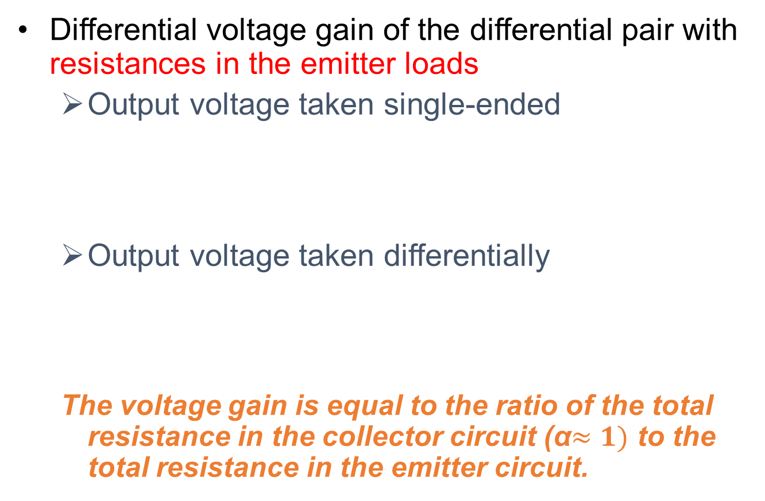
Differential Voltage Gain
Differential voltage gain of the differential pair with resistances in the emitter loads
Output voltage taken single-ended
Output voltage taken differentially
The voltage gain is equal to the ratio of the total resistance in the collector circuit (α$≈1)$ to the total resistance in the emitter circuit.

Slide 7
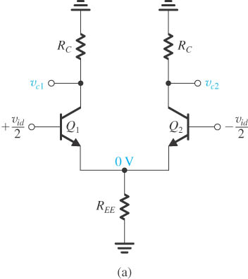
Differential Half-Circuit Analysis
Differential input signals.
Single voltage at joint emitters is zero (AC ground).
The circuit is symmetric.
Equivalent common-emitter amplifiers in (b).

Slide 8
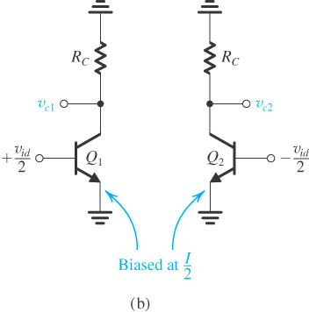
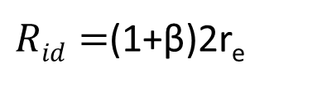
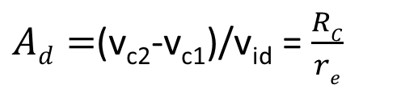
Differential Half-Circuit Analysis
This equivalence applies only for differential input signals.
Either of the two common-emitter amplifiers can be used to find the differential gain, differential input resistance, frequency response, and so on
Half circuit is biased at I/2.
The voltage gain(with the output taken differentially) is equal to the voltage of half circuit.
$Ad=$(v_{c2}-v_{c1})/v_{id} = $\frac{RC}{re}$
$Rid=$(1+β)2r_{e}

Slide 9
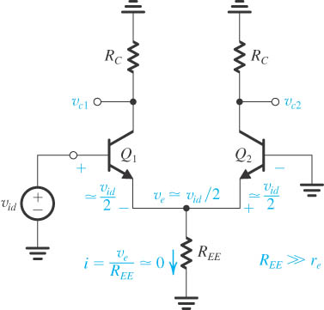
Differential Half-Circuit Analysis
The differential amplifier fed in a single-ended manner.
Signal voltage at the emitter is not zero.
Almost identical to the symmetric one.

Slide 10
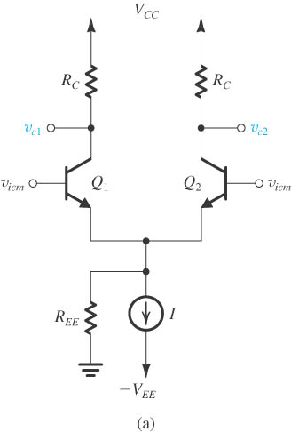
Common-Mode Gain
The differential amplifier fed by a common-mode voltage signal v_{icm}.

Slide 11
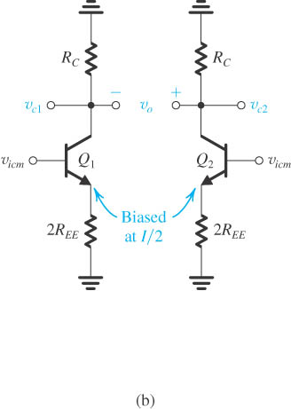
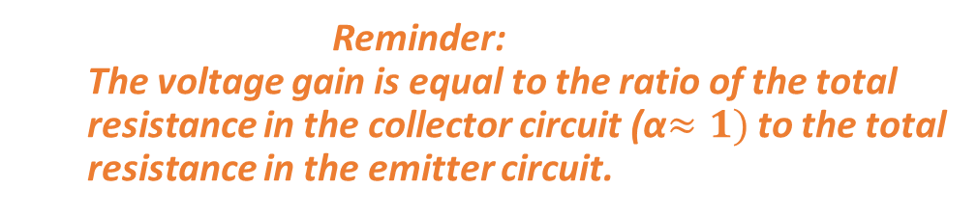
Common-Mode Gain
Reminder:
The voltage gain is equal to the ratio of the total resistance in the collector circuit (α$≈1)$ to the total resistance in the emitter circuit.
Equivalent “half-circuits” for
common-mode calculations.

Slide 12
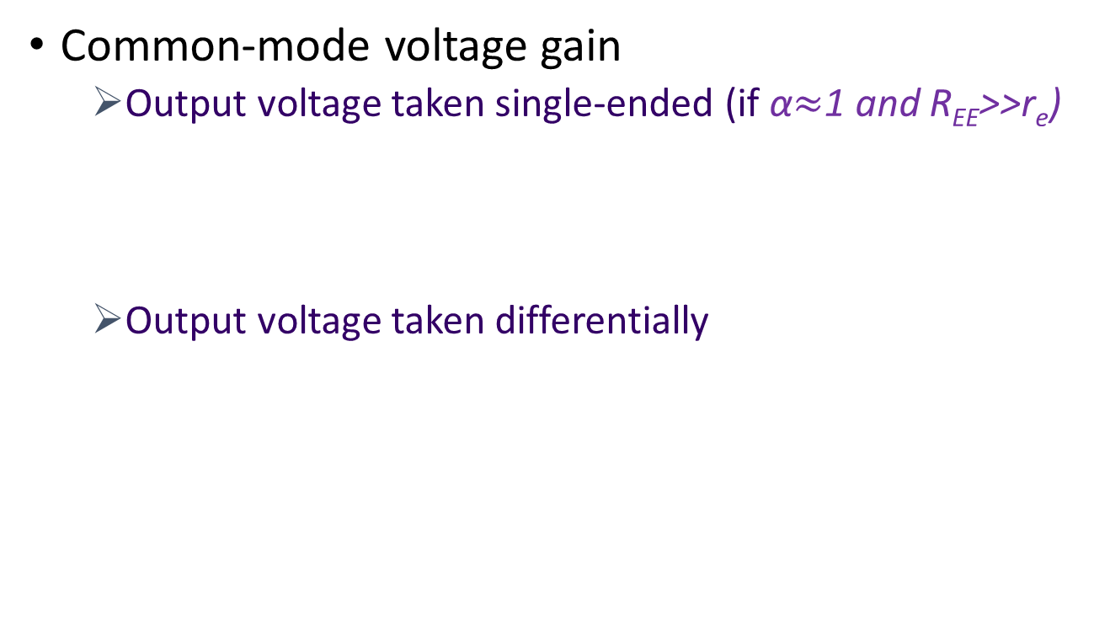
Common-Mode Gain
Common-mode voltage gain
Output voltage taken single-ended (if α$≈$1 and R_{EE}>>r_{e})
Output voltage taken differentially
(*)
Common mode signals cannot be amplified
(**)
v_{icm}

Slide 13
Common-Mode Rejection Ratio
Common-mode rejection ratio
Output voltage taken single-ended
Output voltage taken differentially
This is true only when the circuit is symmetric.
Mismatch on CMRR
(A_{CM} is computed as *)
R_{EE}
( A_{CM} = 0 as **)
Proof: We assume that R_{c} in A_{cm1} expression becomes R_{C}+∆R_{C} and R_{C} in A_{cm2} expression does not change. Then we compute A_{cm} shown in formula above.

Slide 14
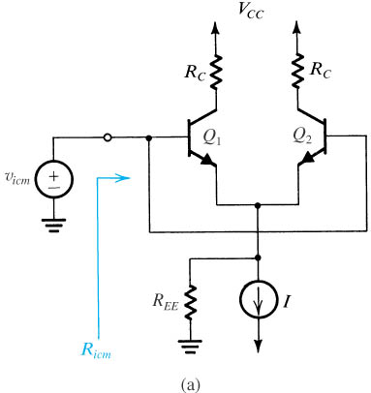
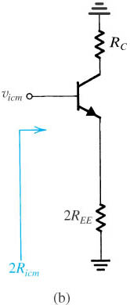
Input Common-Mode Resistance
Definition of the input common-mode resistance R_{icm}.
The equivalent common-mode half-circuit.
Input common-mode resistance is very large.

Slide 15
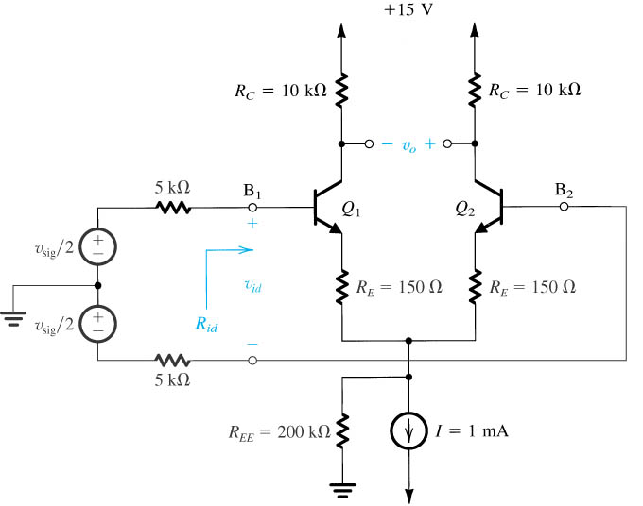
Example 1

Slide 16
Example 1 (cont’d)
The differential amplifier in Fig. uses transistors with β = 100. Evaluate the following:
(a) The input differential resistance R_{id} .
(b) The overall differential voltage gain v_{o}/ v_{sig} (neglect the effect of r_{o}).
(c) The worst-case common-mode gain if the two collector resistances are accurate to within ±1%.
(d) The CMRR, in dB.
(e) The input common-mode resistance (assuming that the Early voltage V_{A} = 100 V).

Slide 17
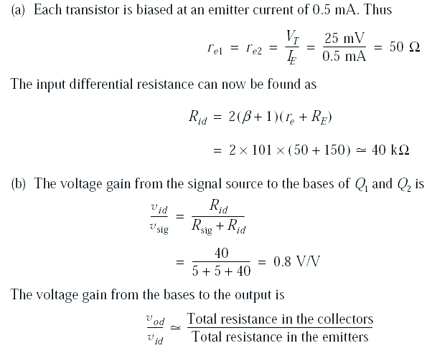
Example 1 – Sol.

Slide 18
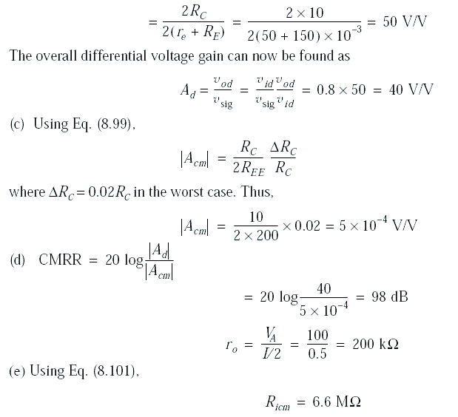
Example 1 – Sol.

Slide 19
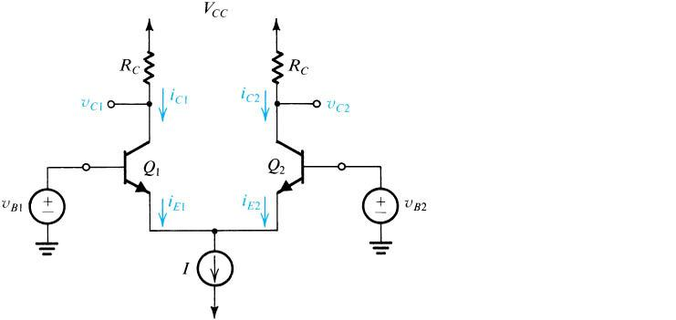
Quiz 3.2
a) Fig. 1 shows a differential amplifier with I = 1mA, R_{C} = 2kΩ, v_{B1} = - v_{B2}, α = 0.99. Q1 and Q2 are matched.
Find differential voltage gain A_{d} = (v_{c2}-v_{c1})/v_{ab} where v_{ab} = v_{a} – v_{b} = v_{B1} - v_{B2}.
Determine differential input resistance R_{ab}.
What is the common mode gain A_{c} of this circuit? What is CMRR?
c
a
b
d
o
o
g
e
o
o
f
b) Fig. 1 shows a differential amplifier with I = 1mA, R_{C} = 2kΩ, v_{B1} = - v_{B2}, α = 0.99. The segments c-a and d-b are replaced by resistance R_{sig} = 200 Ω. Q1 and Q2 are matched.
Find differential voltage gain A_{d} = (v_{c2}-v_{c1})/v_{ab} where v_{ab} = v_{a} – v_{b}
Find v_{ab}/v_{cd}.
Find overall differential voltage gain A_{v} = (v_{c2}-v_{c1})/v_{cd} where v_{cd} = v_{c} – v_{d} = v_{B1} - v_{B2}.
What is the common mode gain A_{c} of this circuit? What is CMRR?
-V_{EE}
Fig. 1

Slide 20
c) Fig. 1 shows a differential amplifier with I = 1mA, R_{C} = 2kΩ, v_{B1} = - v_{B2}, α = 0.99. The segments c-a and d-b are replaced by resistance R_{sig} = 200 Ω. The segments e-g and f-g are replaced by R_{E} = 50 Ω. Q1 and Q2 are matched.
Find differential voltage gain A_{d} = (v_{c2}-v_{c1})/v_{ab} where v_{ab} = v_{a} – v_{b}
Find v_{ab}/v_{cd}.
Find overall differential voltage gain A_{v} = (v_{c2}-v_{c1})/v_{cd} where v_{cd} = v_{c} – v_{d} = v_{B1} - v_{B2}.
What is the common mode gain A_{c} of this circuit? What is CMRR?
d) Fig. 2 shows a differential amplifier where the biasing circuit (DC circuit) is not shown. R_{C} = 4kΩ, R_{EE} = 100kΩ, r_{e1} = r_{e2} = 50 Ω and α = 0.99. Q1 and Q2 are matched.
Find differential voltage gain A_{d} = (v_{c2}-v_{c1})/v_{id}.
If the actual value of R_{C} is specified to be within plus or minus 10% of the nominal value (4kΩ), find the common mode gain A_{c}.
Compute CMRR in dB?
Fig. 2
You submit your solution not later than March 27, 2020.

Slide 21
d) Fig. 2 shows a differential amplifier where the biasing circuit (DC circuit) is not shown. R_{C} = 4kΩ, R_{EE} = 100kΩ, r_{e1} = r_{e2} = 50 Ω and α = 0.99. Q1 and Q2 are matched.
Find differential voltage gain A_{d} = (v_{c2}-v_{c1})/v_{id}.
If the actual value of R_{C} is specified to be within plus or minus 10% of the nominal value (4kΩ), find the common mode gain A_{c}.
Compute CMRR in dB?
Fig. 2
You submit your solution not later than March 27, 2020.

